Slide 1
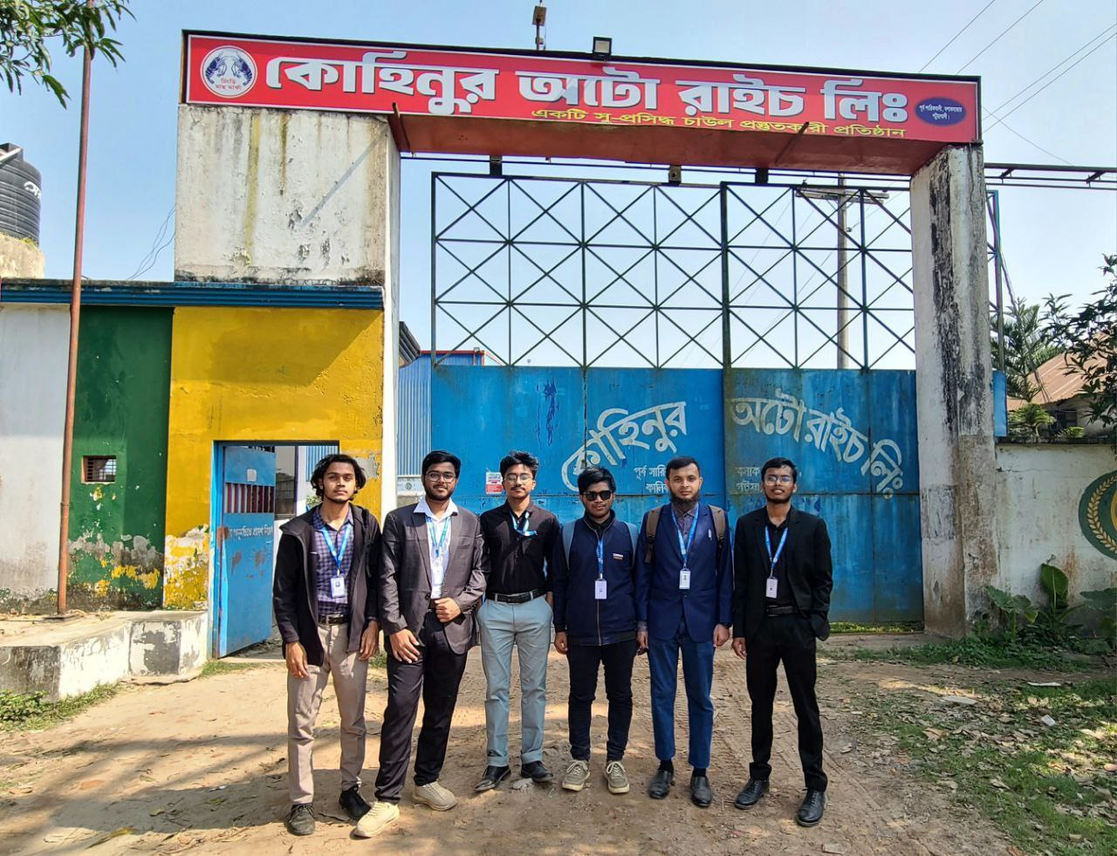
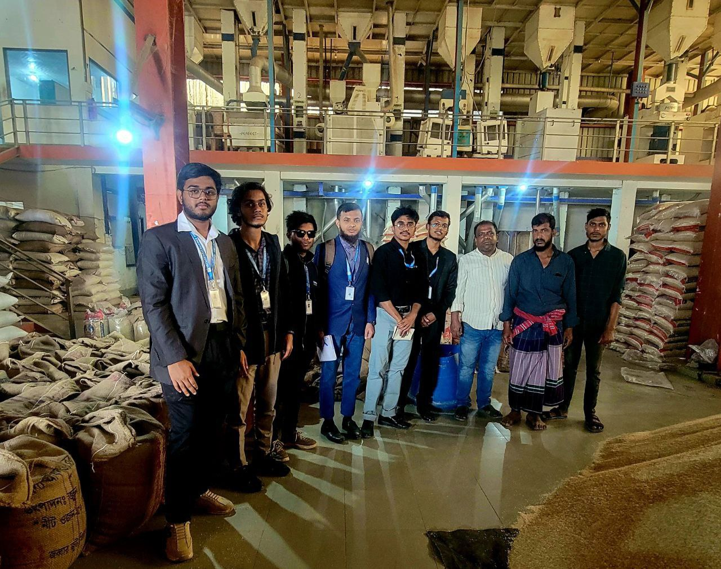
Industry Visit
Kohinoor Auto Rice Ltd.
Date: 13-04-2025

Slide 2
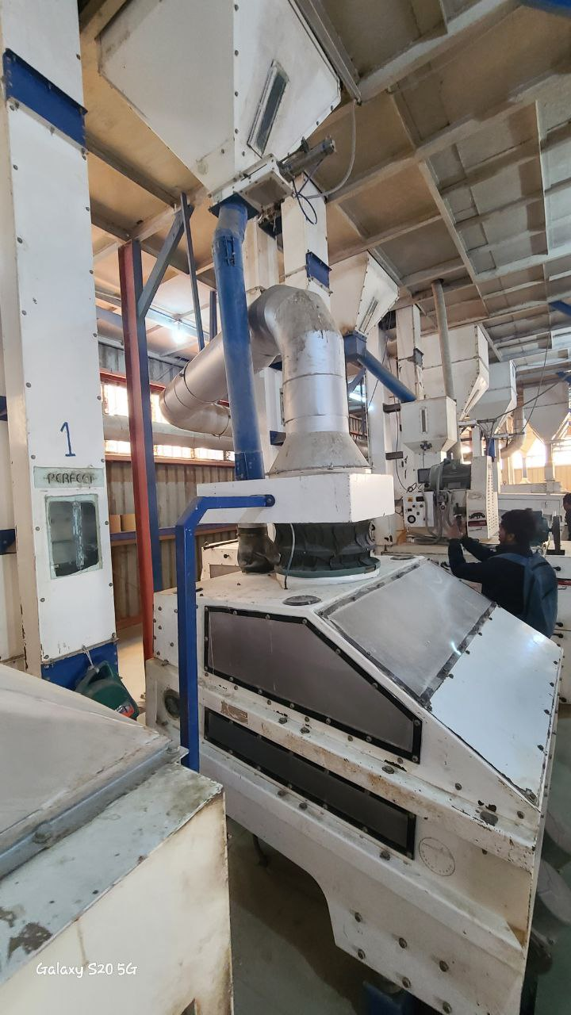
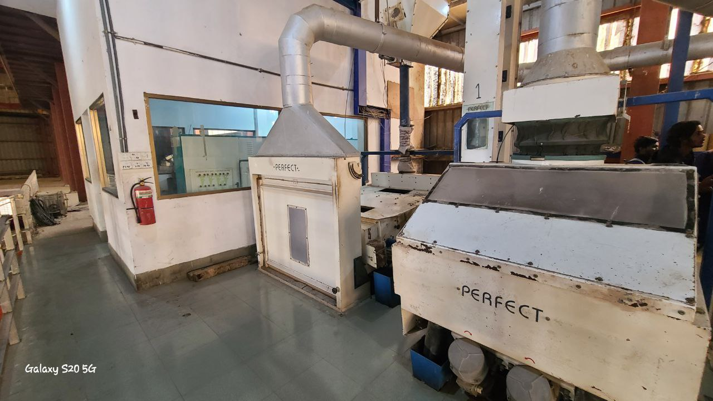
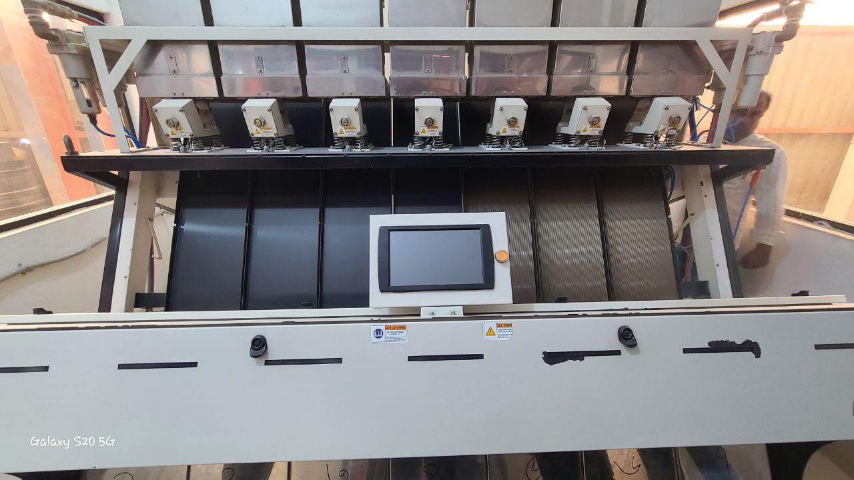
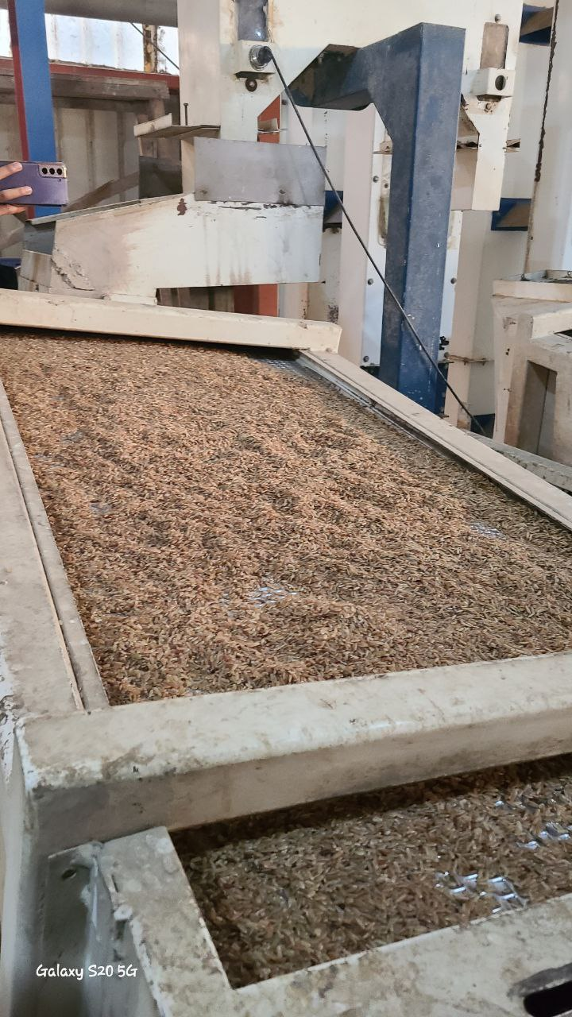
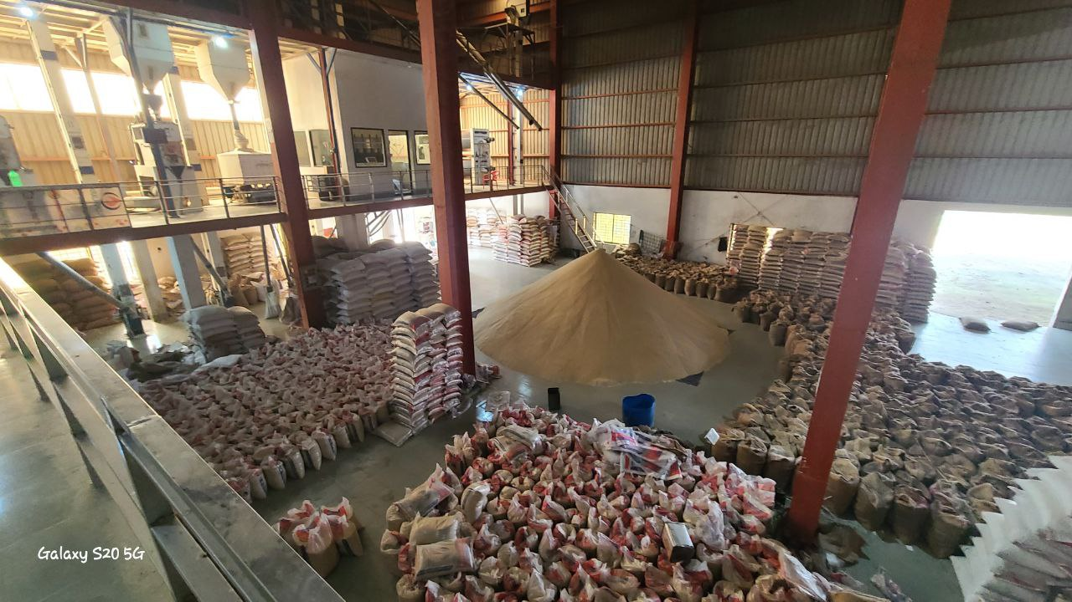
The Process and Packaging System

Slide 3
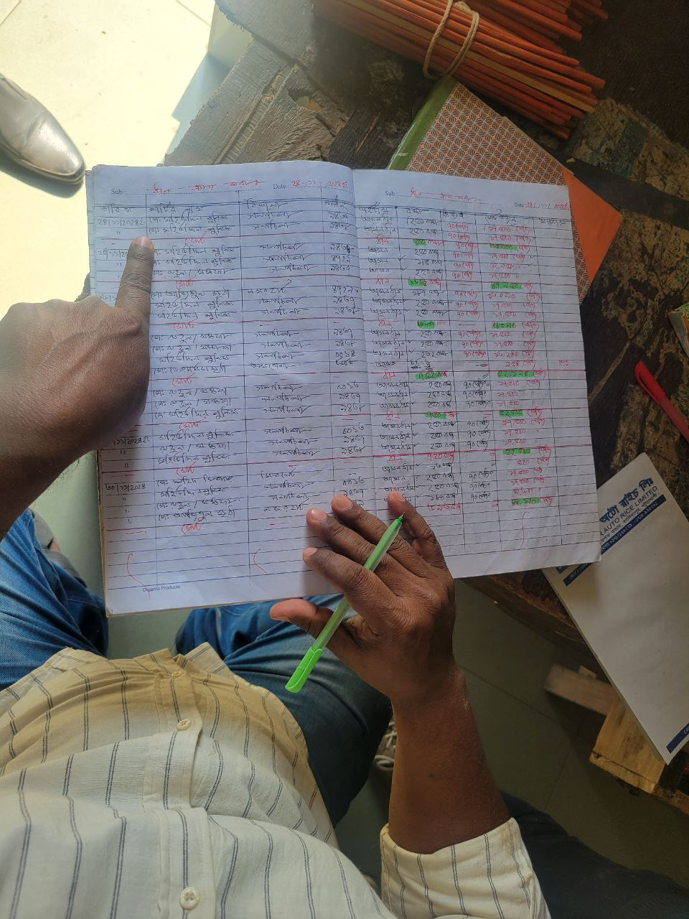
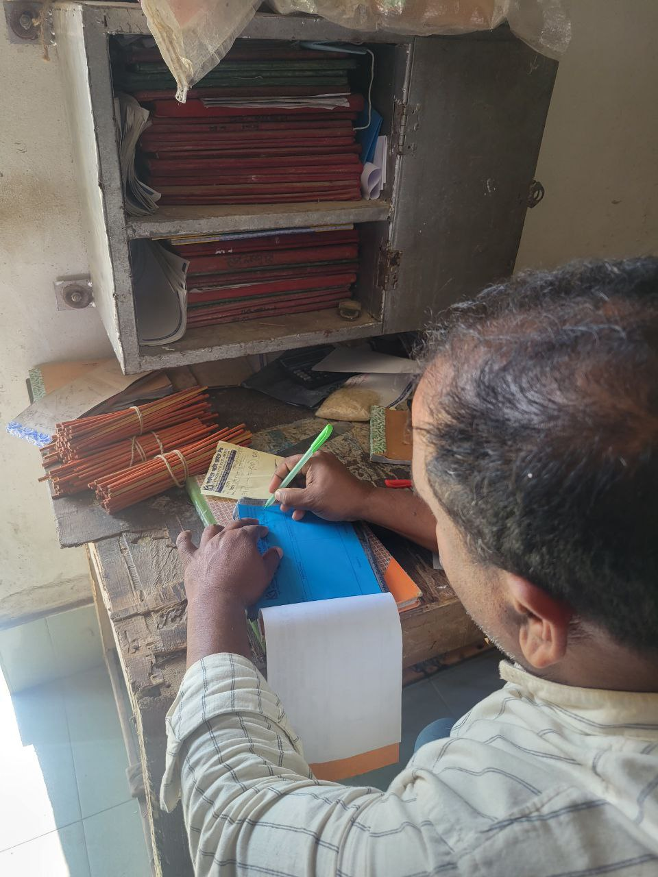
Current Management System
Current System is somewhat backdated, we tried to modernize it

Slide 4

INVENTORY MANAGEMENT SYSTEM
Kohinoor Auto Rice Ltd.
Mobin Haque
ID: 2102064
Reg: 10191
Farhadul Haque Fuad
ID: 2102067
Reg: 10194
Raghib Al Shahriar
ID: 2102073
Reg: 10200

Slide 5
Why we have selected Auto Rice Mills?
Potential Software Market
Demand of the Automation Software
Visible Problems to be Solve

Slide 6
Feasibility Analysis
There are Thousands of Rice Mills in Bangladesh
Almost 60% of them uses Backdated Process
Technical Feasibilty (Modernization of the current process)
Economic Feasibility (Low Cost, High ROI)
Operational Feasibility (Impact on Business, Automation, Optimization, Training and Support)
Risk Assesment (Technical Issues)

Slide 7
Target Users
Inventory Managers
Production Supervisors
Sales and Dispatch Officers
Administrative Staff
Development Platform
Programming Language: C#
Framework: .NET
Database: SQL-Server

Slide 8
Business Policies
Our Software will be free of cost
We will only charge on monthly Subscription
Monthly Subscription Price ( Negotiable)
OR
Can Buy the Software at the First Place
Price Negotiable
Further development and support will be charged

Slide 9
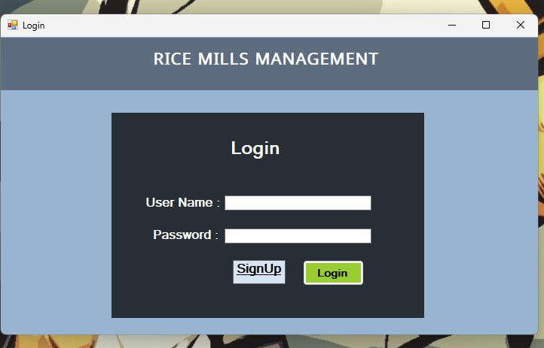
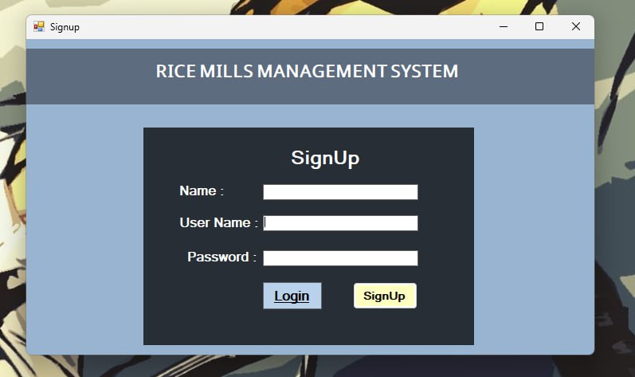
LOGIN SIGNUP :

Slide 10
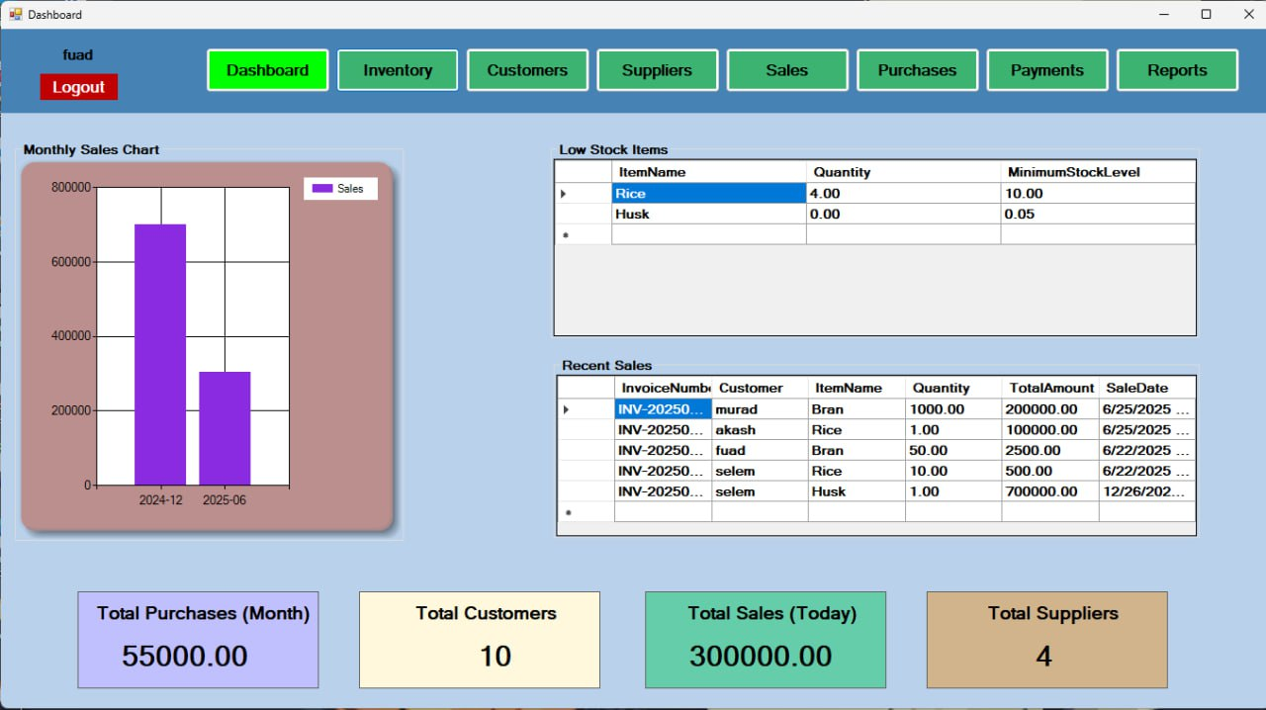
Dashboard:

Slide 11
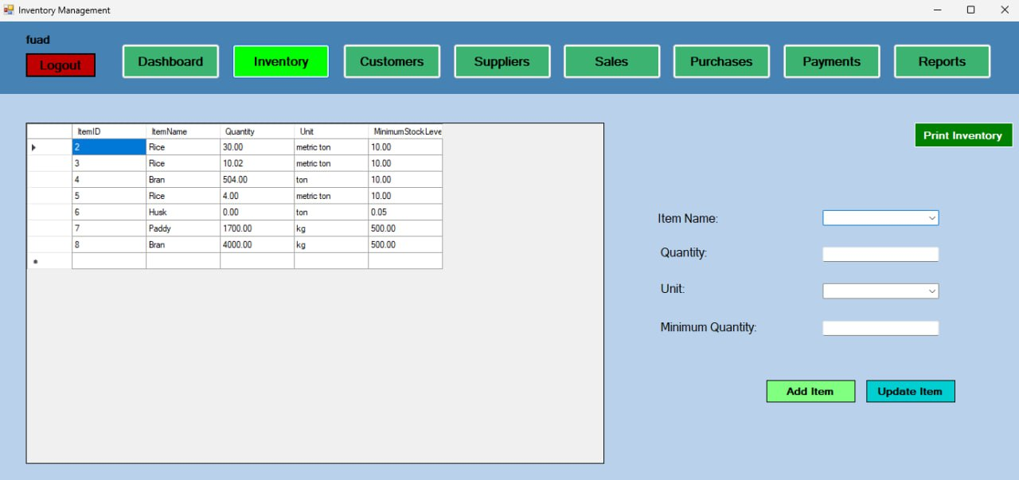
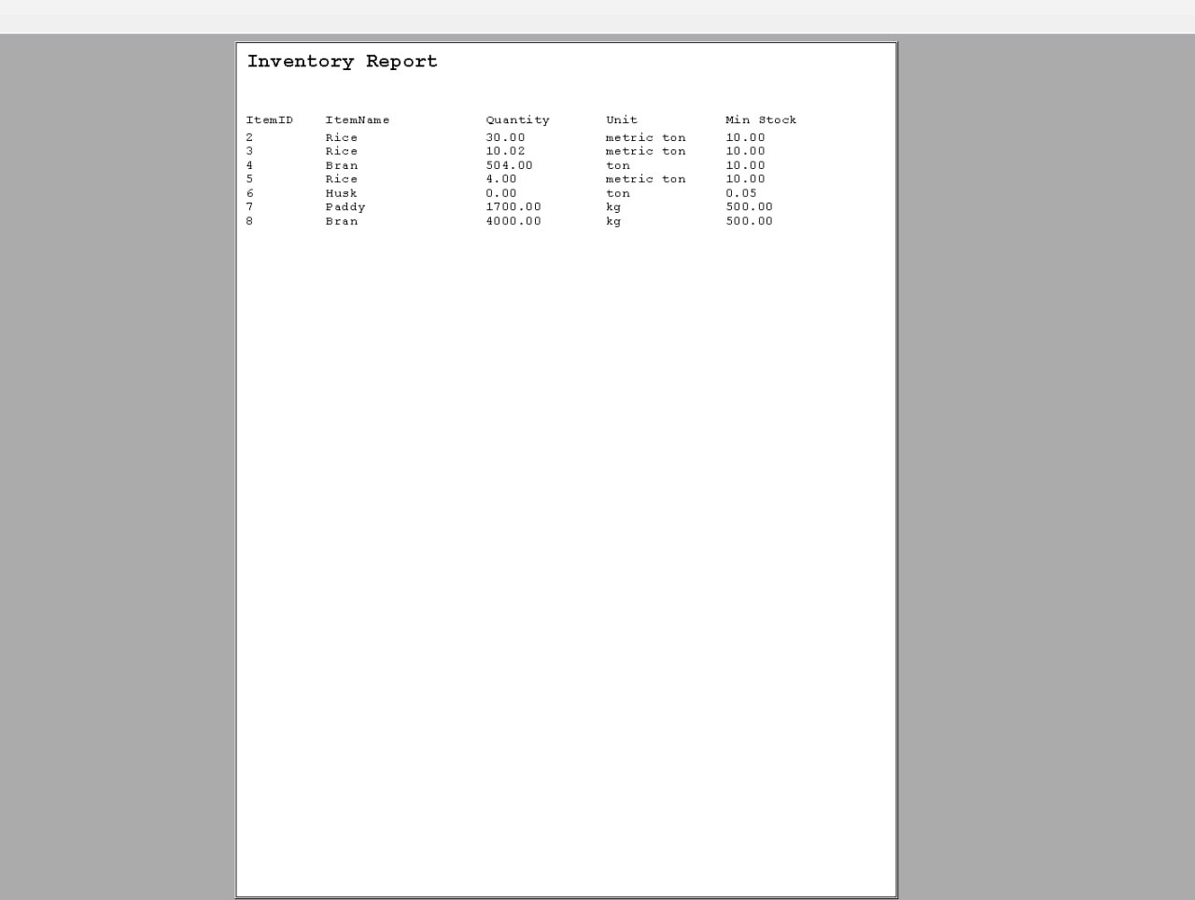
Inventory Report
Inventory:

Slide 12
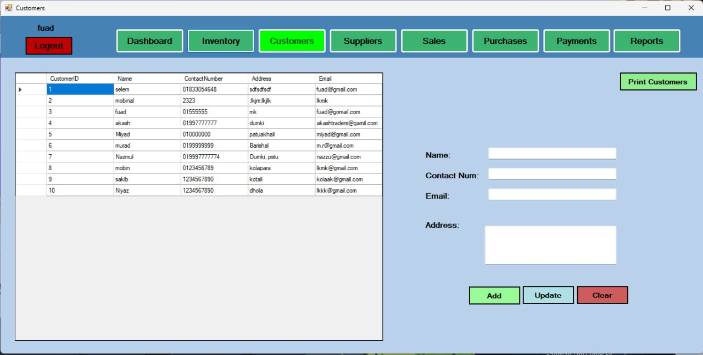
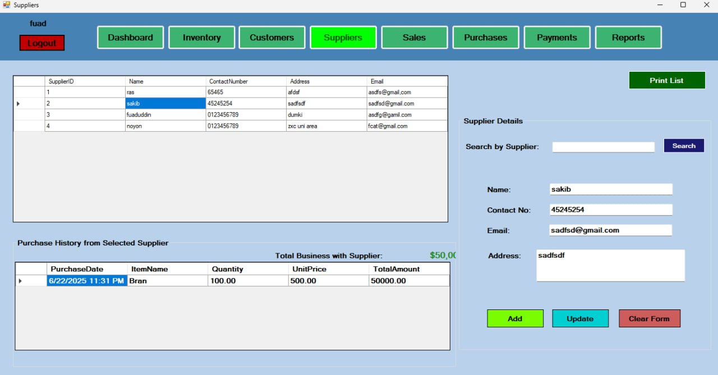
Suppliers:
Customers:

Slide 13
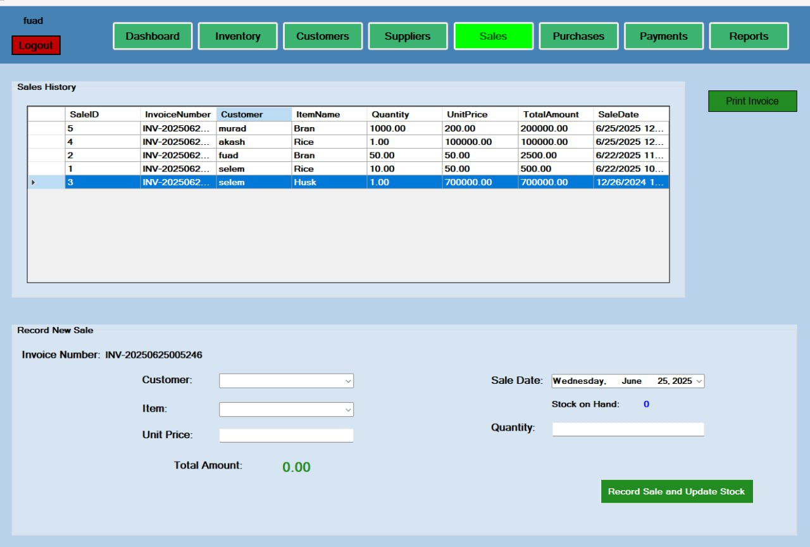
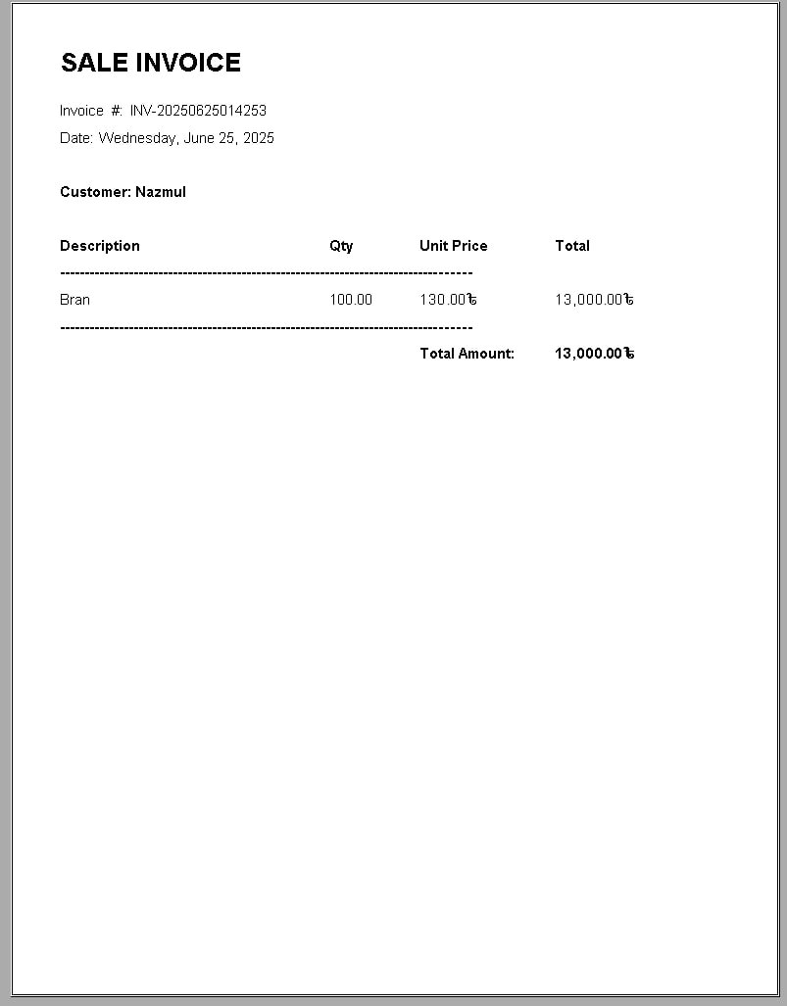
Invoice
Sales

Slide 14
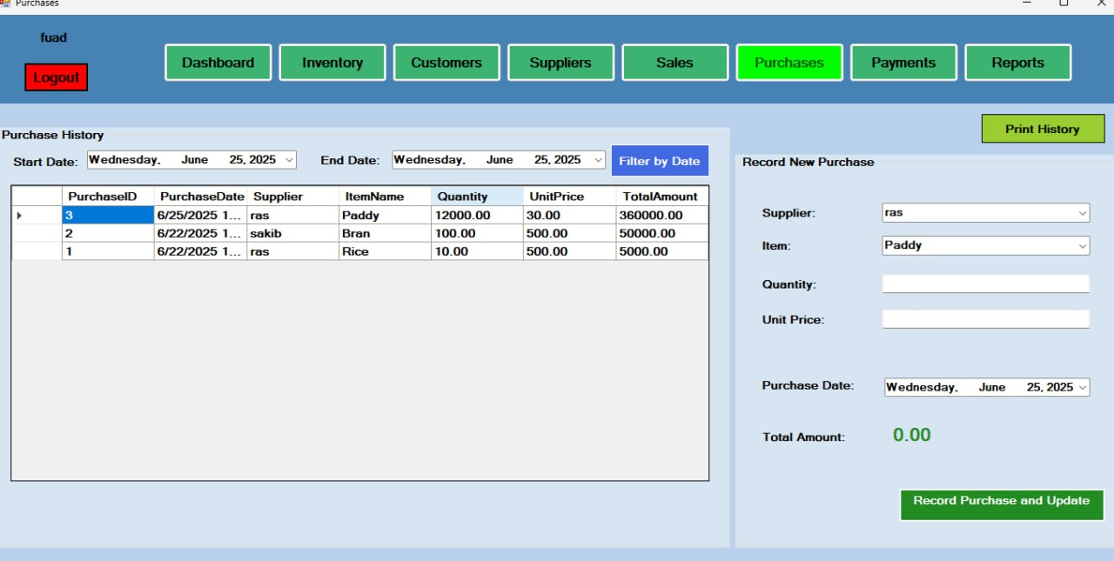
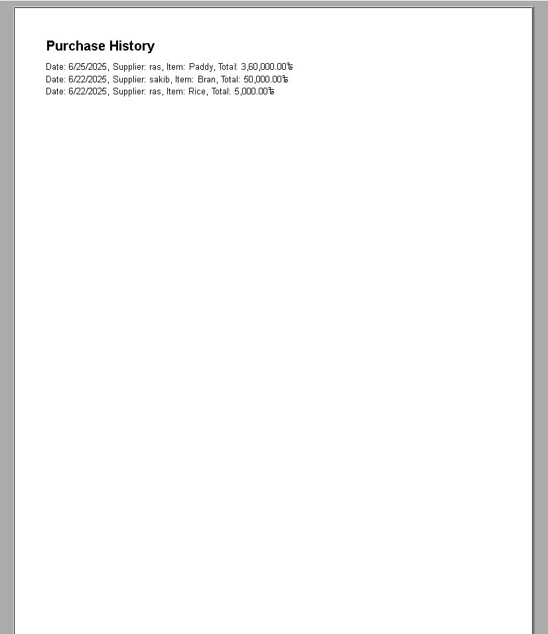
History
Purchases

Slide 15
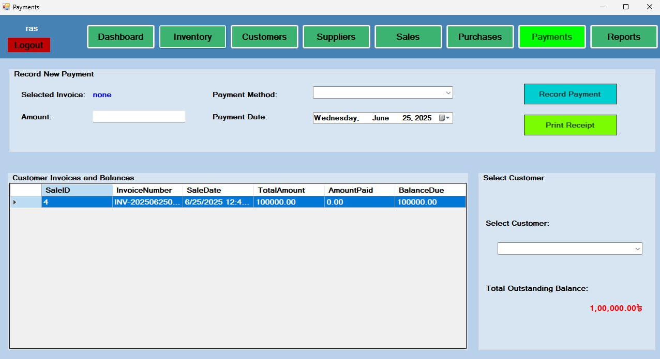
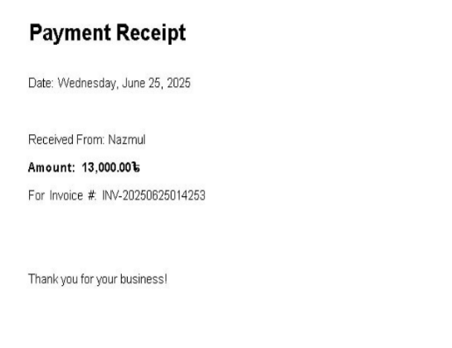

Slide 16
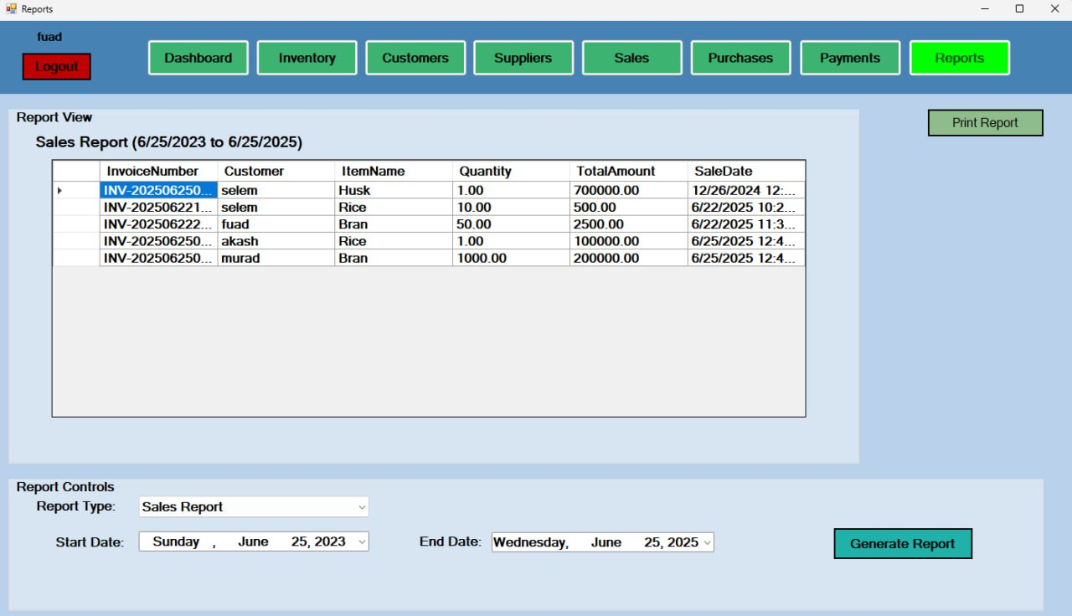
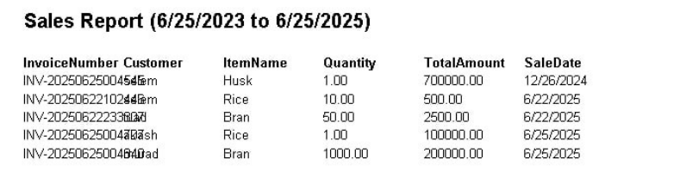

Slide 17
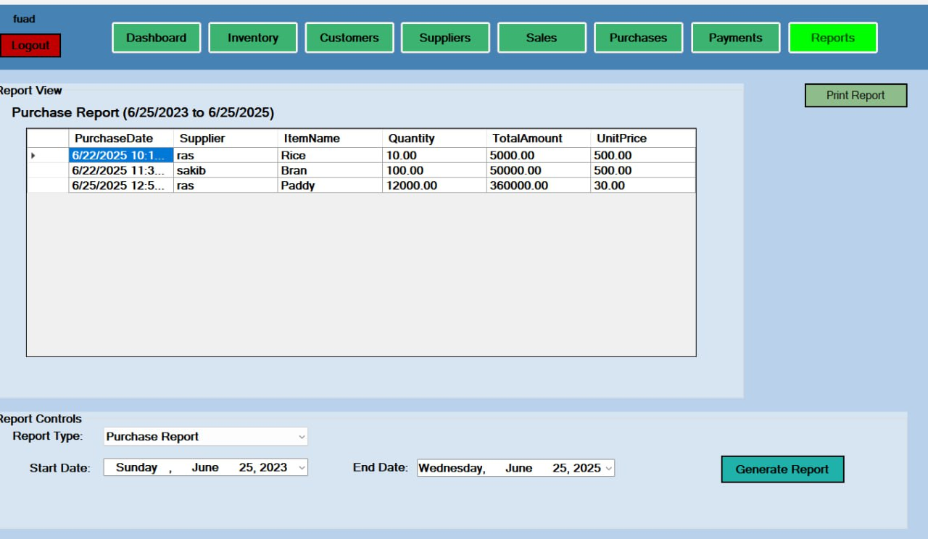
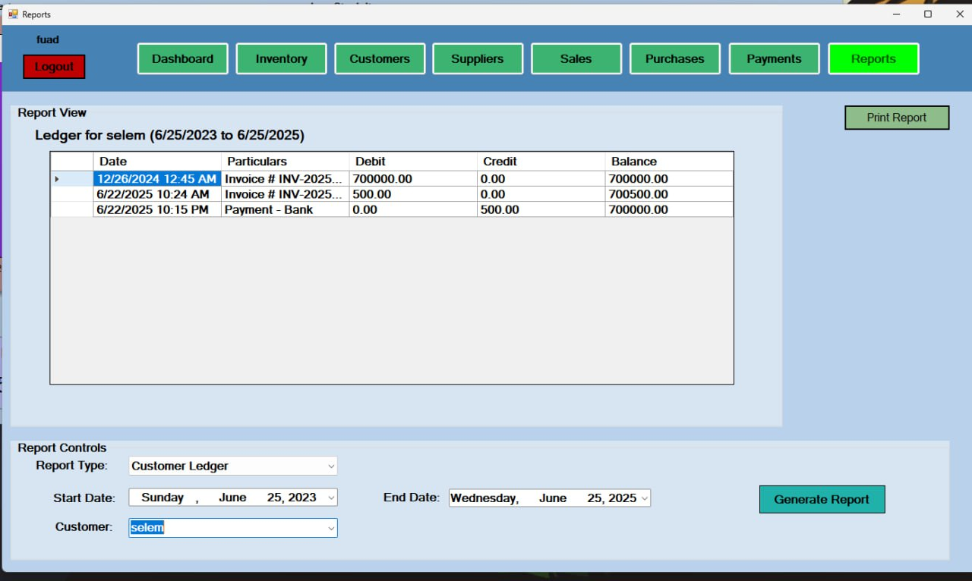
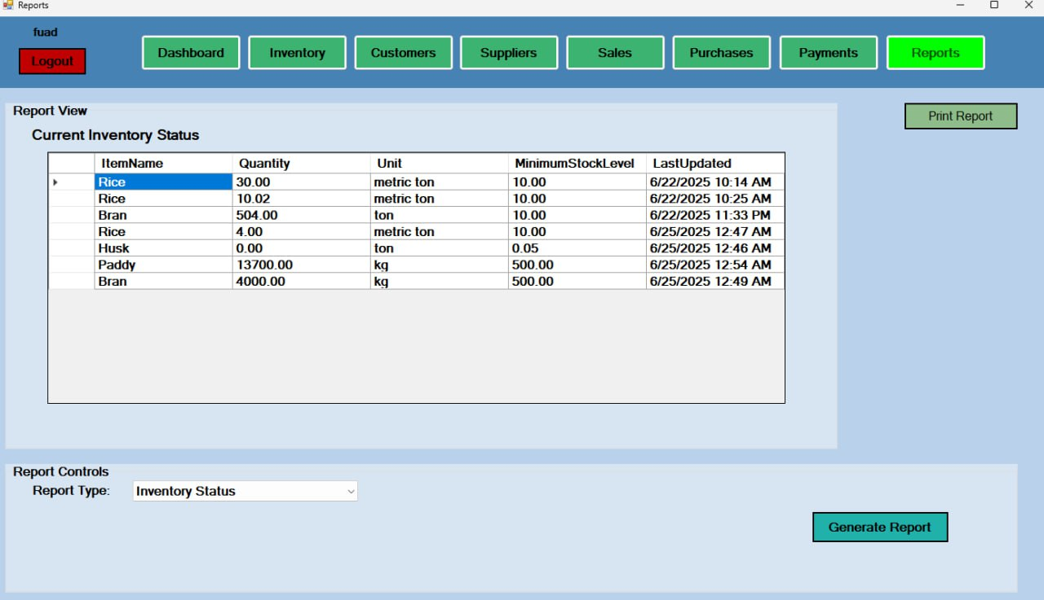

Slide 18
THANK YOU

